Slide 1

Analysis of Property Prices In the different Boroughs In London and other influences on the property price.

Slide 2
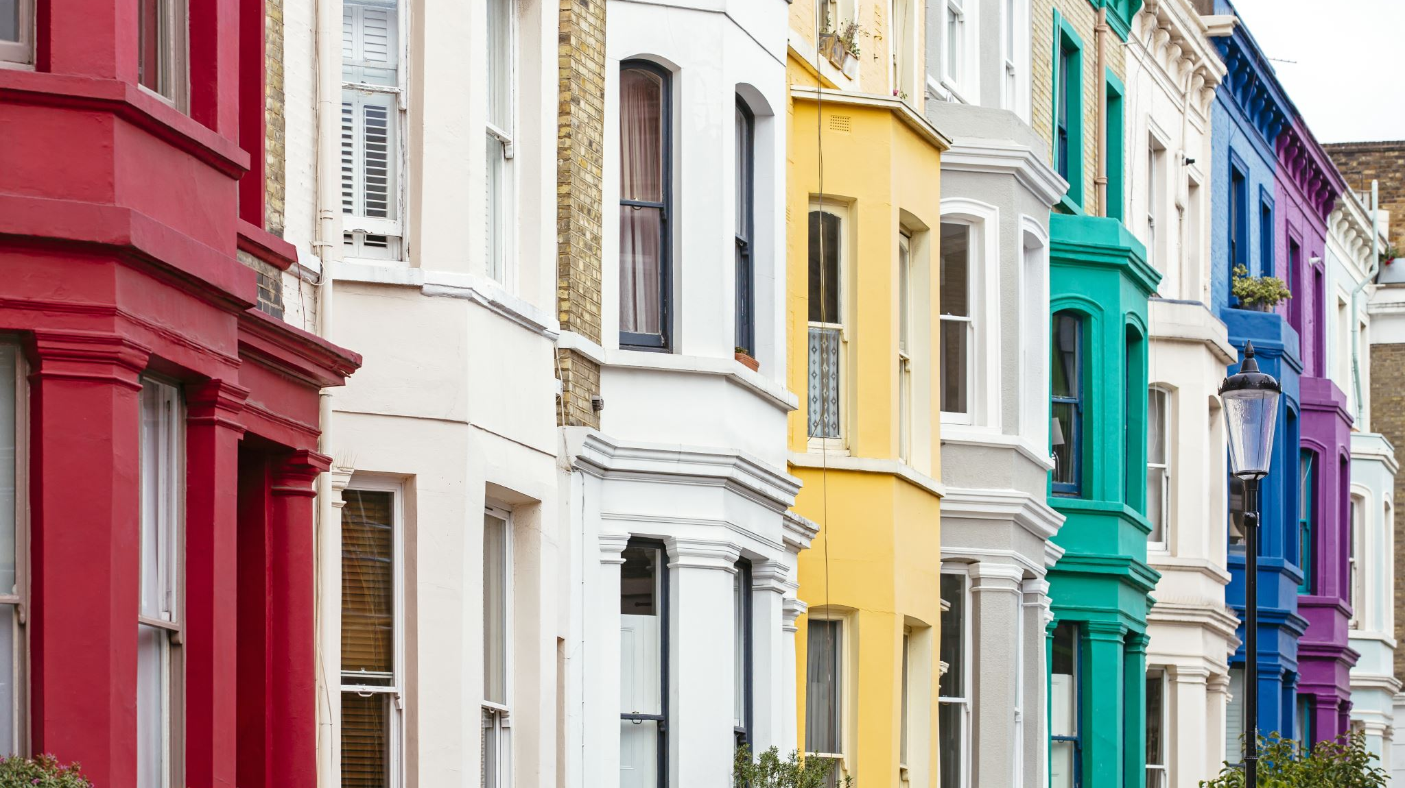
What are the most popular types of Properties for sale in London?

Slide 3
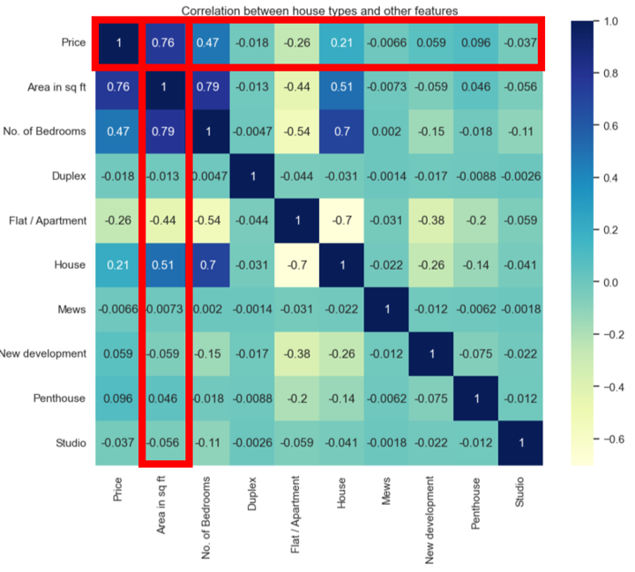
Correlation between house types and other features
Notes:
In this heatmap, the main part to look at is the 'house type' and the other features. There isn't much of a correlation between these values as it is close to 0 indicating no correlation. However, we can see that as the 'area in sq. ft’ increases, the price increases. This is shown by the Pearson's r value of 0.76. This indicates a strong positive correlation.

Slide 4
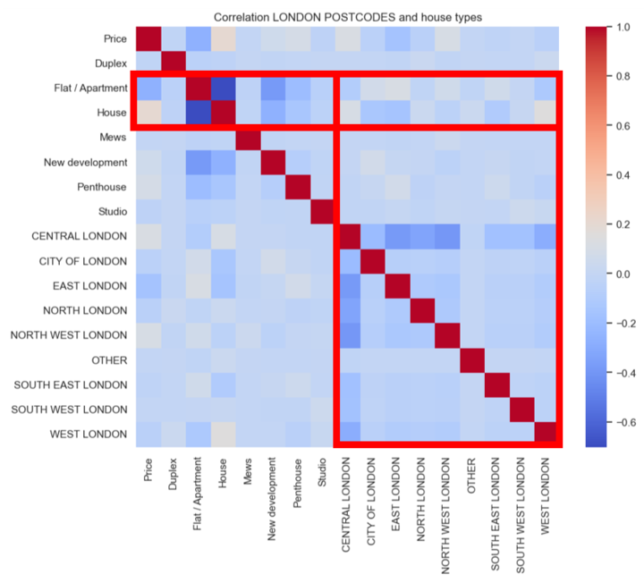
Correlation between London Postcodes and House Types
Notes:
In this heatmap, the main part to look at is the 'London Postcodes' and the 'House Types'. There isn't much of a correlation between these values as it is close to 0 indicating no correlation. However, looking at the colours in the heatmap, the most common 'House Type' for each 'London Postcode' are houses and flats which is indicated by the 'beige' colour.

Slide 5
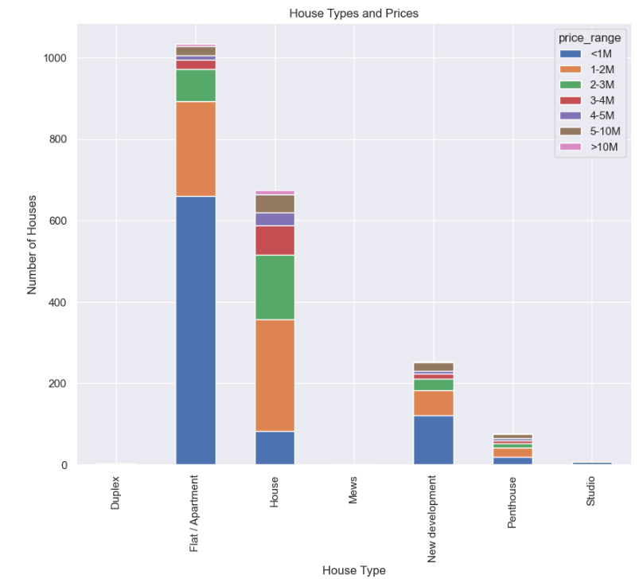
House Types and Prices
Notes:
In this bar chart we can see that 'flat/apartments' are mostly sold at a lower price compared to other 'House Types', which may influence why it is the most sold property in London.

Slide 6
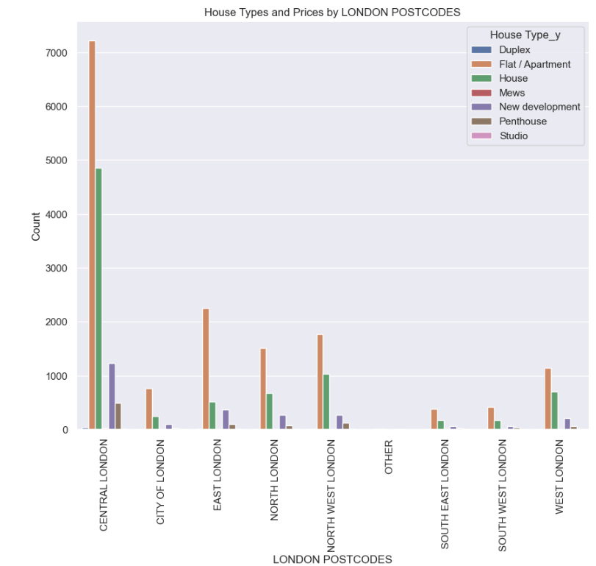
House Types and Prices by London Postcodes
Notes:
Central London has the highest population density compared to other 'London Postcodes' that's why it has the 'tallest' bar. Form this data we can see that for all 'London Postcode', flat/apartment are the most sold and it could be due to many reasons. One reason could be, due to London being the financial centre of England making it a highly desirable city to live in.

Slide 7

What is the correlation between house prices and average salary in London? Which areas have a higher salary?

Slide 8
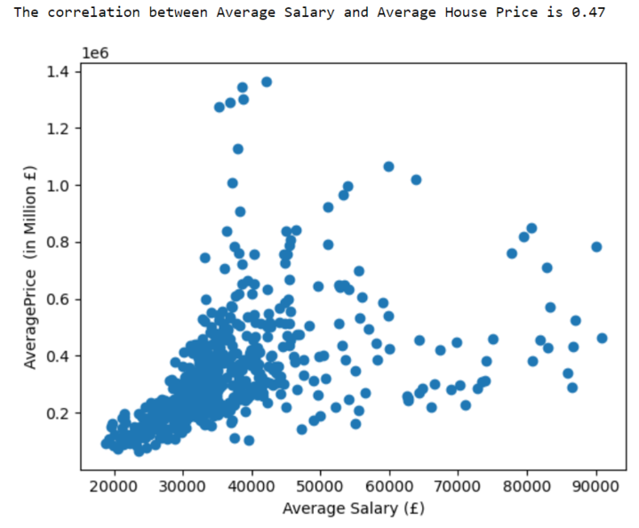
Average Salary vs. Average House Price

Slide 9
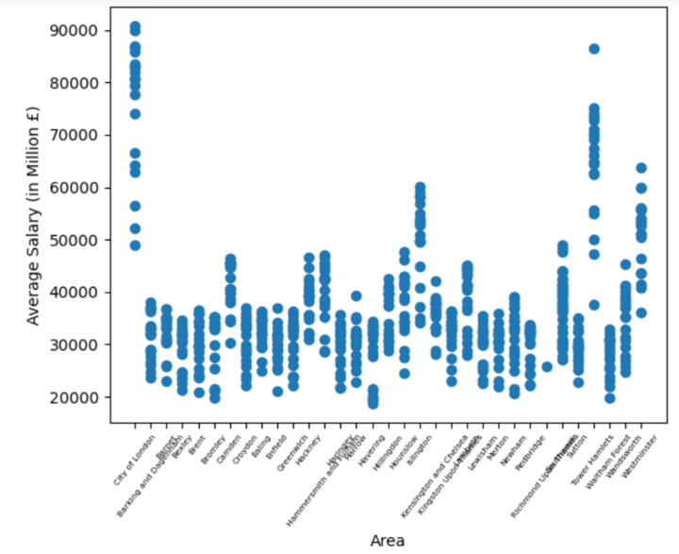
Area vs. Average Salary

Slide 10
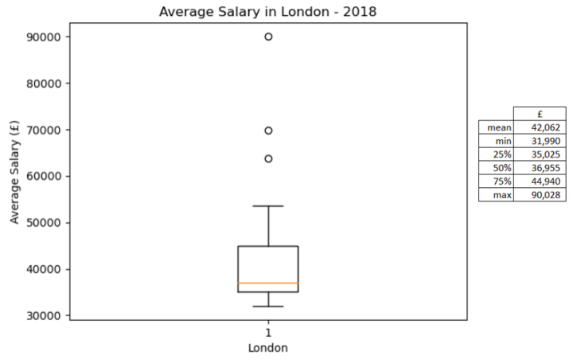
Average Salary in London in 2018

Slide 11

How do property prices in London compare with other major cities in the UK over the last 25 years?

Slide 12
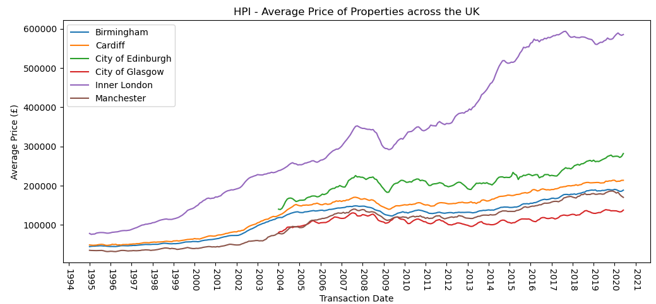

Slide 13
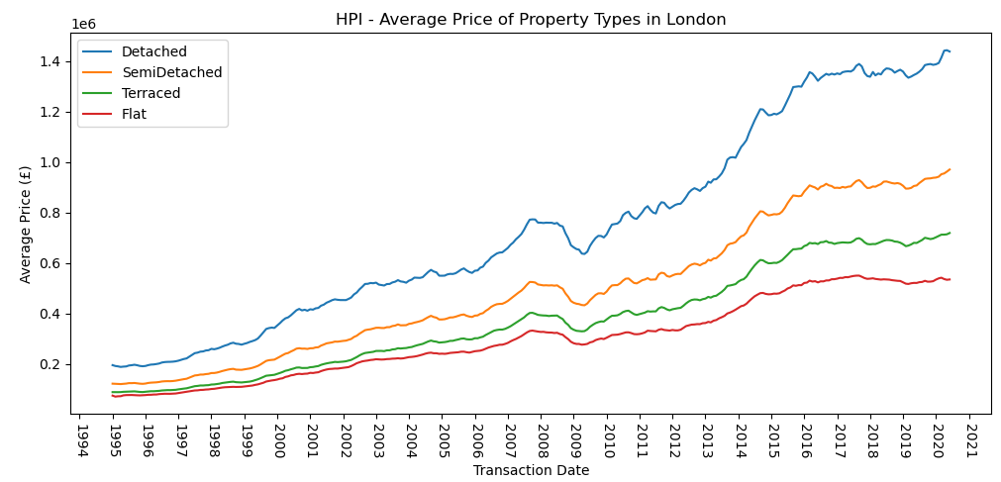

Slide 14
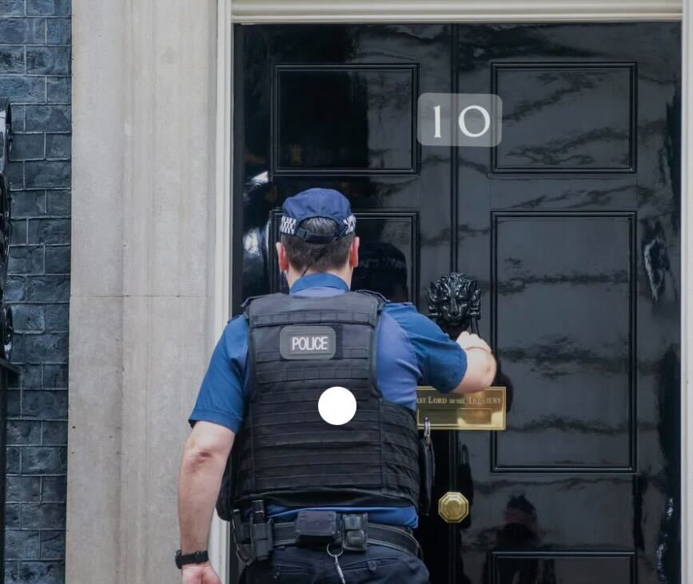
What is the correlation between house prices and crime statistics?

Slide 15
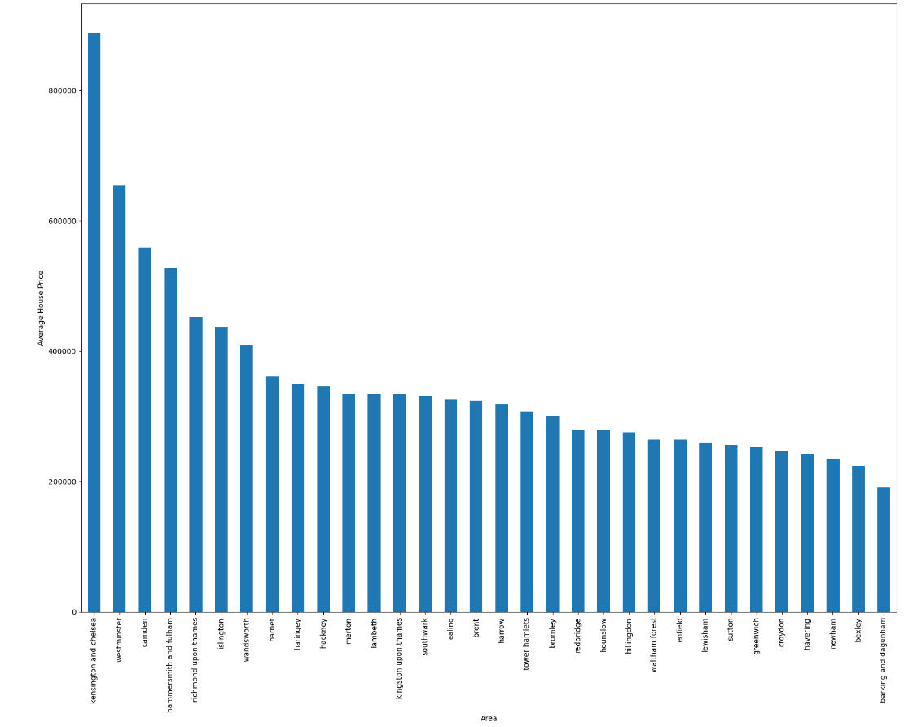
Average House Price per area
Notes:
From the bar plot representing the average house price vs areas, we can see that the highest house prices are in following areas: Kensington and Chelsea Westminster Camden Hammersmith&Fullham Richmond upon Thames Islington.

Slide 16
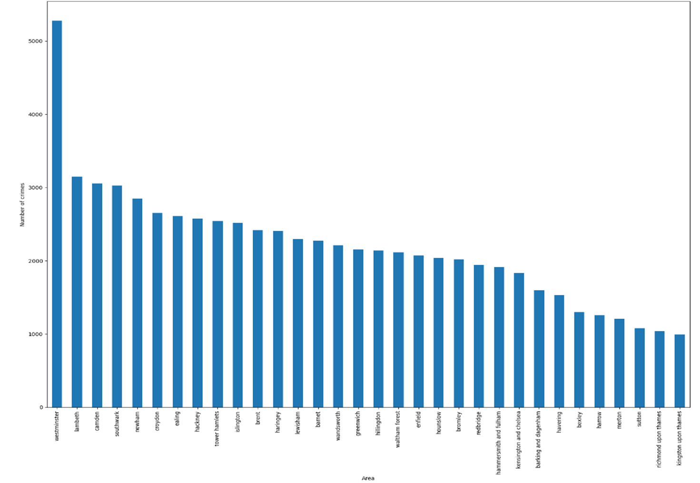
Number of Crimes per area
Notes:
From the bar plot representing the number of crimes per area, we can observe a much higher number of crimes in Westminster, which is skewing the data. However, this is likely due to Westminster (and other high crime concentration areas) being a busy tourist spot. This explains the high amount of price.

Slide 17
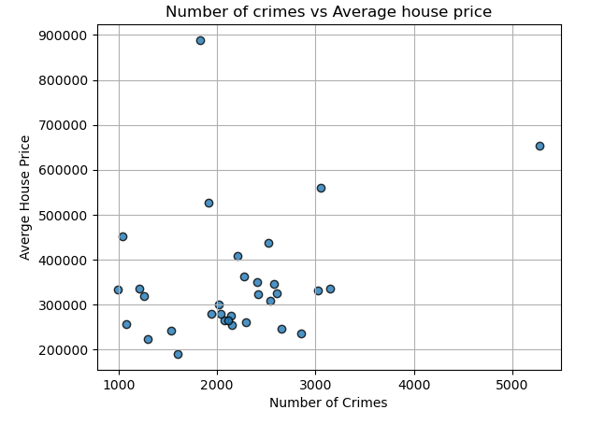
Correlation: 0.305
Notes:
According to the correlation calculation and the scatter plot, we see a weak correlation between the average house price and the number of crimes. In the future research it may help to remove some of the city centre and tourist reas from the data to help understand this potential correlation better. The data is also not the most reliable as some areas were lacking in crime numbers or the crimes statistics was recorded poorly.

Slide 18


Fried Chicken vs. Espresso Martini?

Slide 19
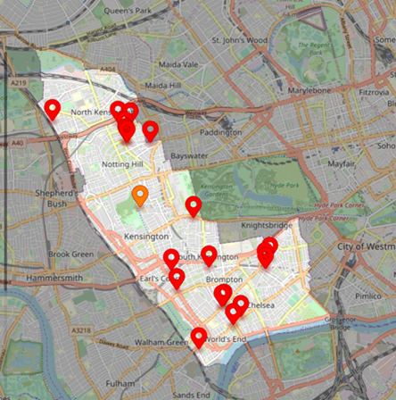
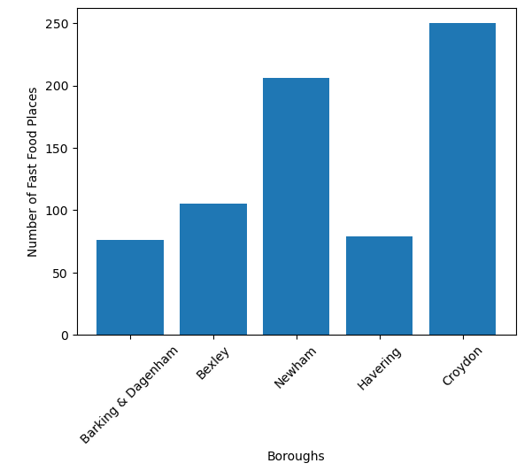
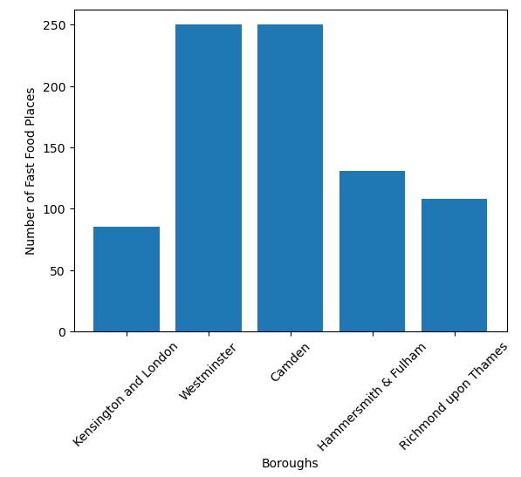
Number of Fast-Food Shops
Notes:
ANALYSIS OF DATA FOR BOTTOM 5 AVERAGE HOUSE PRICES IN LONDON BOROUGHS
With the use of Places API Playground we looked locating the number of fast food places and bars
Focus was given to the bottom 5 boroughs by average house prices: (i) Barking & Dagenham (ii) Bexley (iii) Newham (iv) Havering (v) Croydon
On analysis of the data it can be seen that Westminster is an outlier and skewing the data for both number of fast food placed and number of bars.
Barking and Havering have the lowest figures for fast food places.
Barking and Havering also show the lowest figures for fast food places.

Slide 20
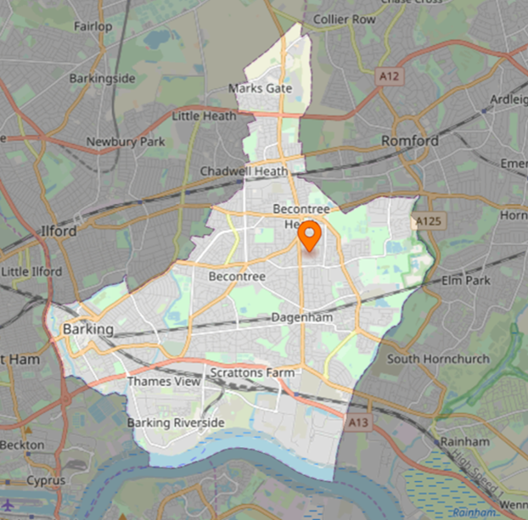
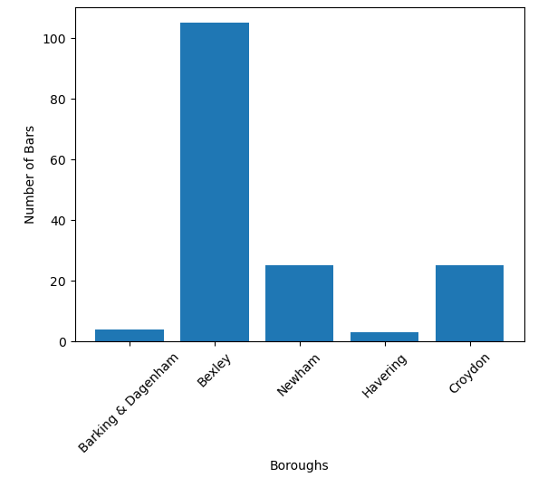
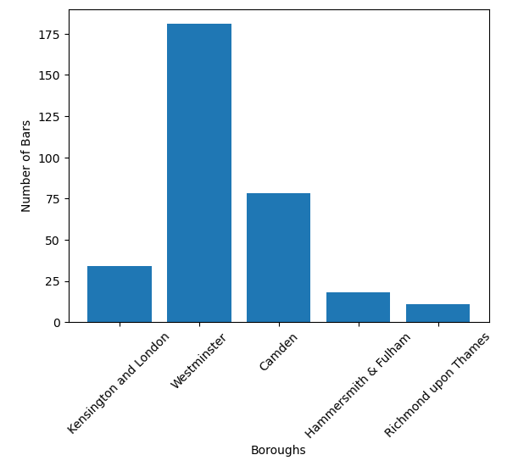
Number of Bars
Notes:
ANALYSIS OF DATA FOR TOP 5 AVERAGE HOUSE PRICES IN LONDON BOROUGHS
With the use of Places API Playground we looked locating the number of fast food places and bars
Focus was given to the top 5 boroughs by average house prices: (i) Kensington & Chelsea (ii) Westminster (iii) Camden (iv) Hammersmith & Fulham (v) Richmond upon Thames
On analysis of the data it can be seen that Westminster is an outlier and skewing the data for both number of fast food placed and number of bars.
Hammesmith and Richmond show the lowest figures for bars.
Kensington and Richmond show the lowest figures for fast food places

Slide 21
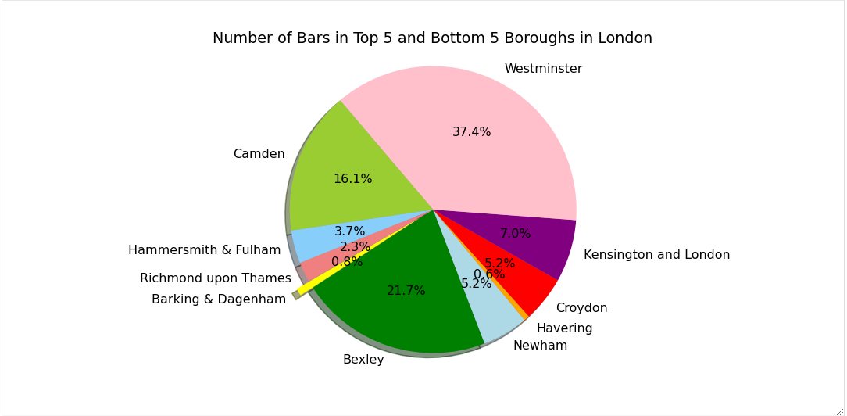
Number of Bars and Restaurants

Slide 22
Analysis and Conclusion
Flats and apartments are the most common type of property to lived in, and square footage is the factor that has the biggest impact on how much a property is worth.
They are also mostly sold at a lower price compared to other 'House Types', which may influence why it is the most sold property type in London.
Central London has the highest population density compared to other 'London Postcodes.
The highest house prices are in following areas: Kensington and Chelsea, Westminster, Camden Hammersmith & Fulham, Richmond upon Thames, and Islington.
Where the crimes were at the highest, these were tourist areas.
House prices have increased almost 8 times the cost over the last 25 years

Slide 23
QUESTIONS?

Slide 24
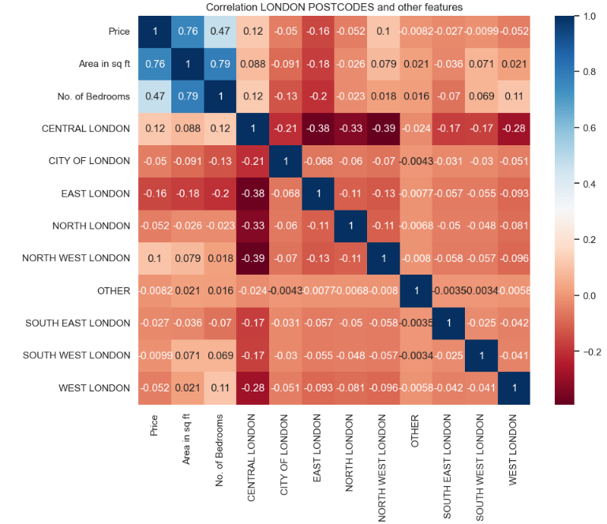
In this heatmap, the main part to look at is the 'London Postcodes' and the 'price'. There isn't much of a correlation between these values as it is close to 0 indicating no correlation.

Slide 25
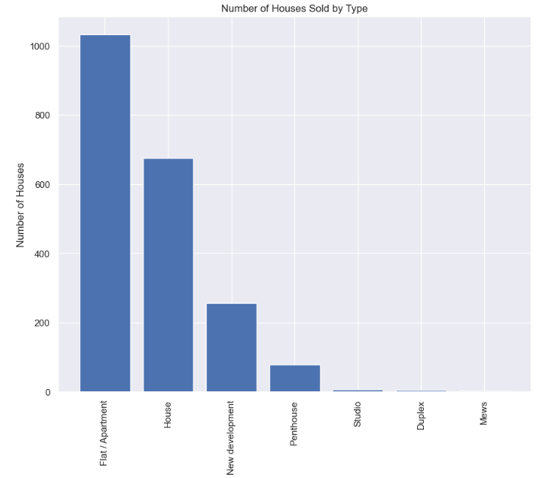
From this bar chart we can see that 'flat/apartments’ are the most sold property in London and the least is 'Mews'.

Slide 26
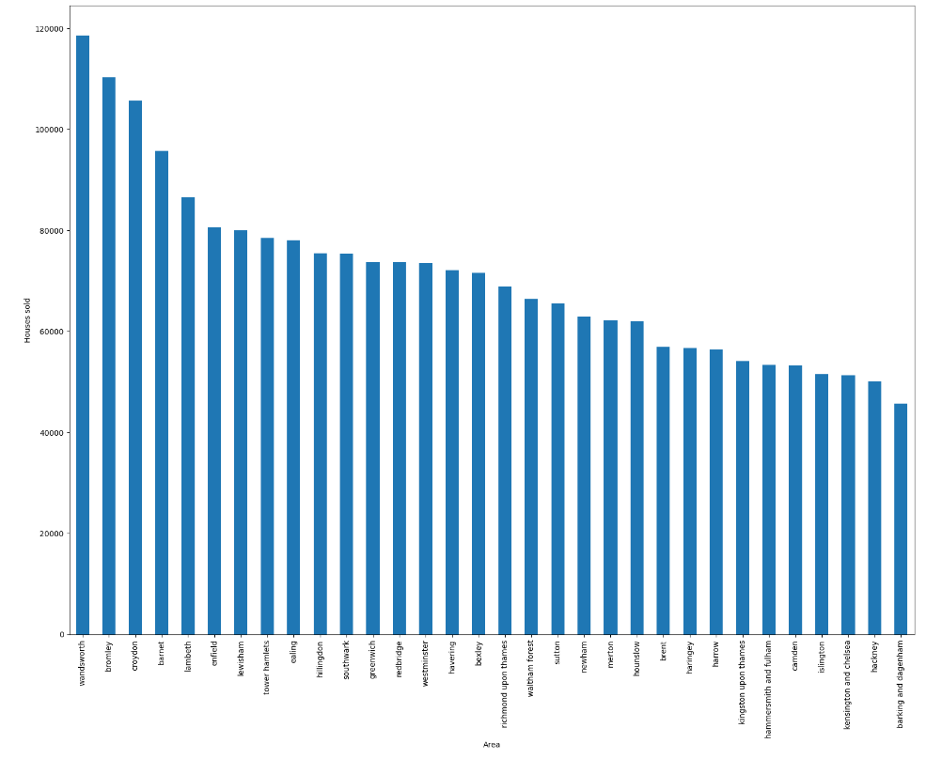
Houses sold per area
Notes:
Add summary here

